Slide 1
Customized dataset augmentation using diffusion methods
Aditya Chakravarty, PhD

Slide 2
Objective : generate photo realistic, high-resolution image similar to a training dataset
Potential Approaches :
GAN architectures
Unconditional image generation (DDPM)
Fine tuned Stable diffusion

Slide 3
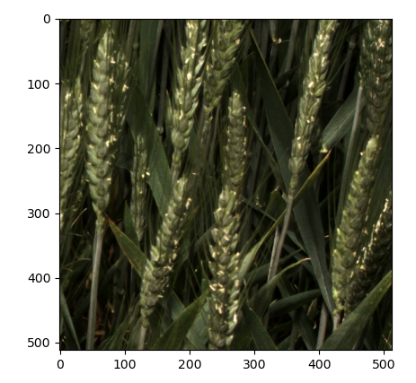
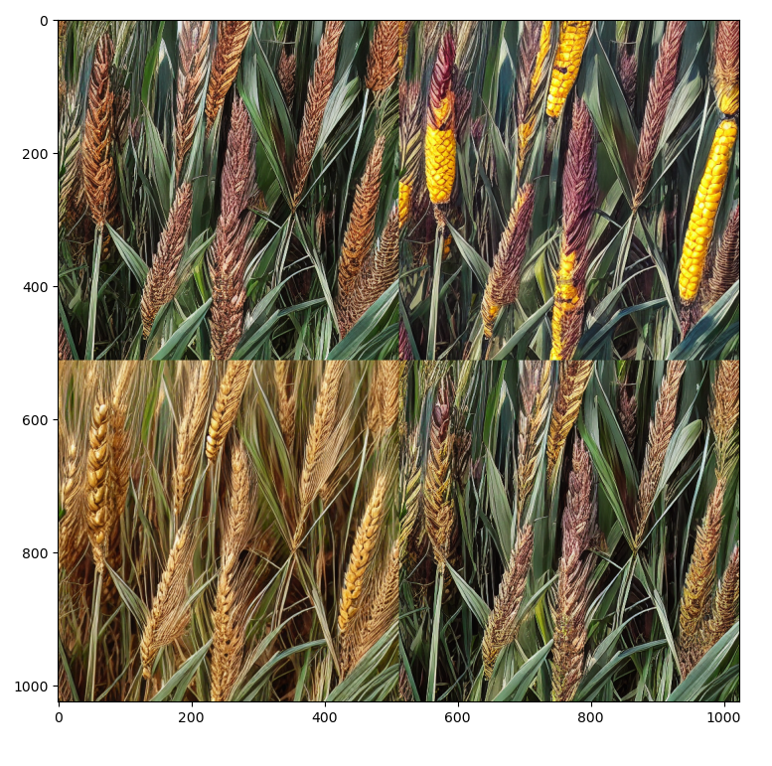
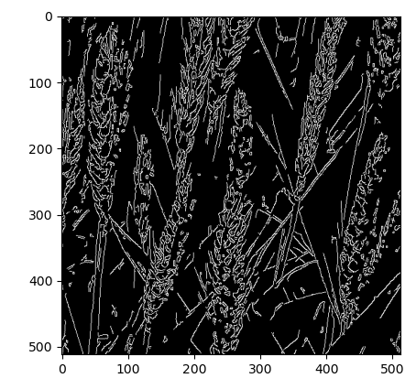
prompt = "natural, green, best quality, extremely detailed"
prompt = [t + prompt for t in ["soy crop", "corn crop", "wheat crop", "crop in farm"]]

